Slide 1



Retail Business Insights
View in Power BI
Last data refresh:
02/06/2025 01:00:36 UTC
Downloaded at:
02/06/2025 01:03:43 UTC

Slide 2
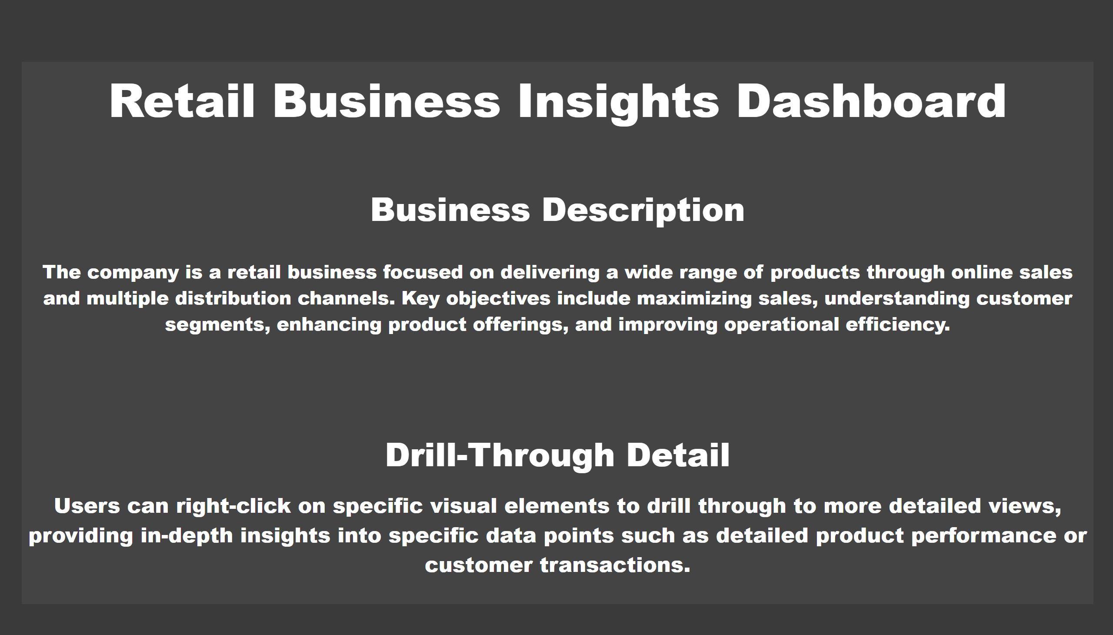
Introduction
Notes:
textbox
No alt text provided

Slide 3
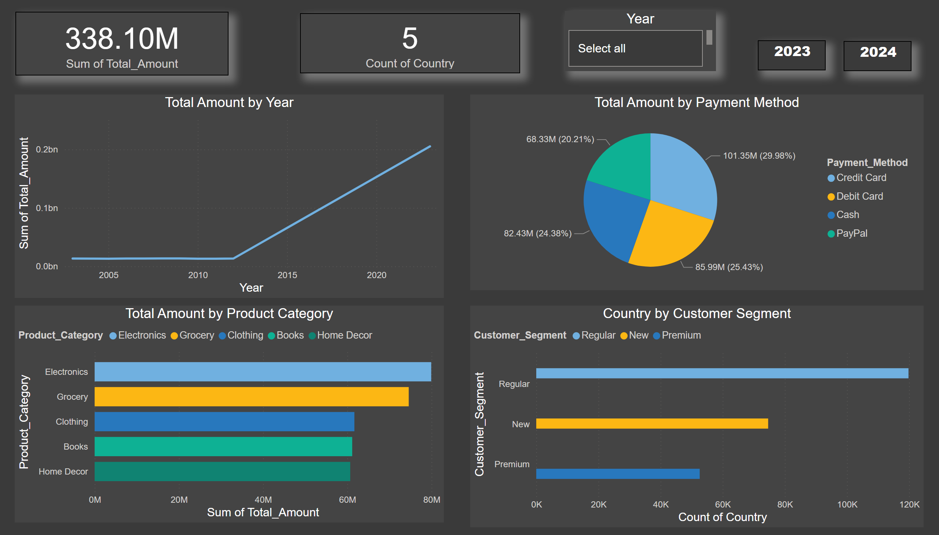
Sales Dashboard
Notes:
Total Amount by Product Category
No alt text provided
Total Amount by Year
No alt text provided
Total Amount by Payment Method
No alt text provided
Country by Customer Segment
No alt text provided
card
No alt text provided
card
No alt text provided
advancedSlicerVisual
No alt text provided
2023
No alt text provided
2024
No alt text provided

Slide 4
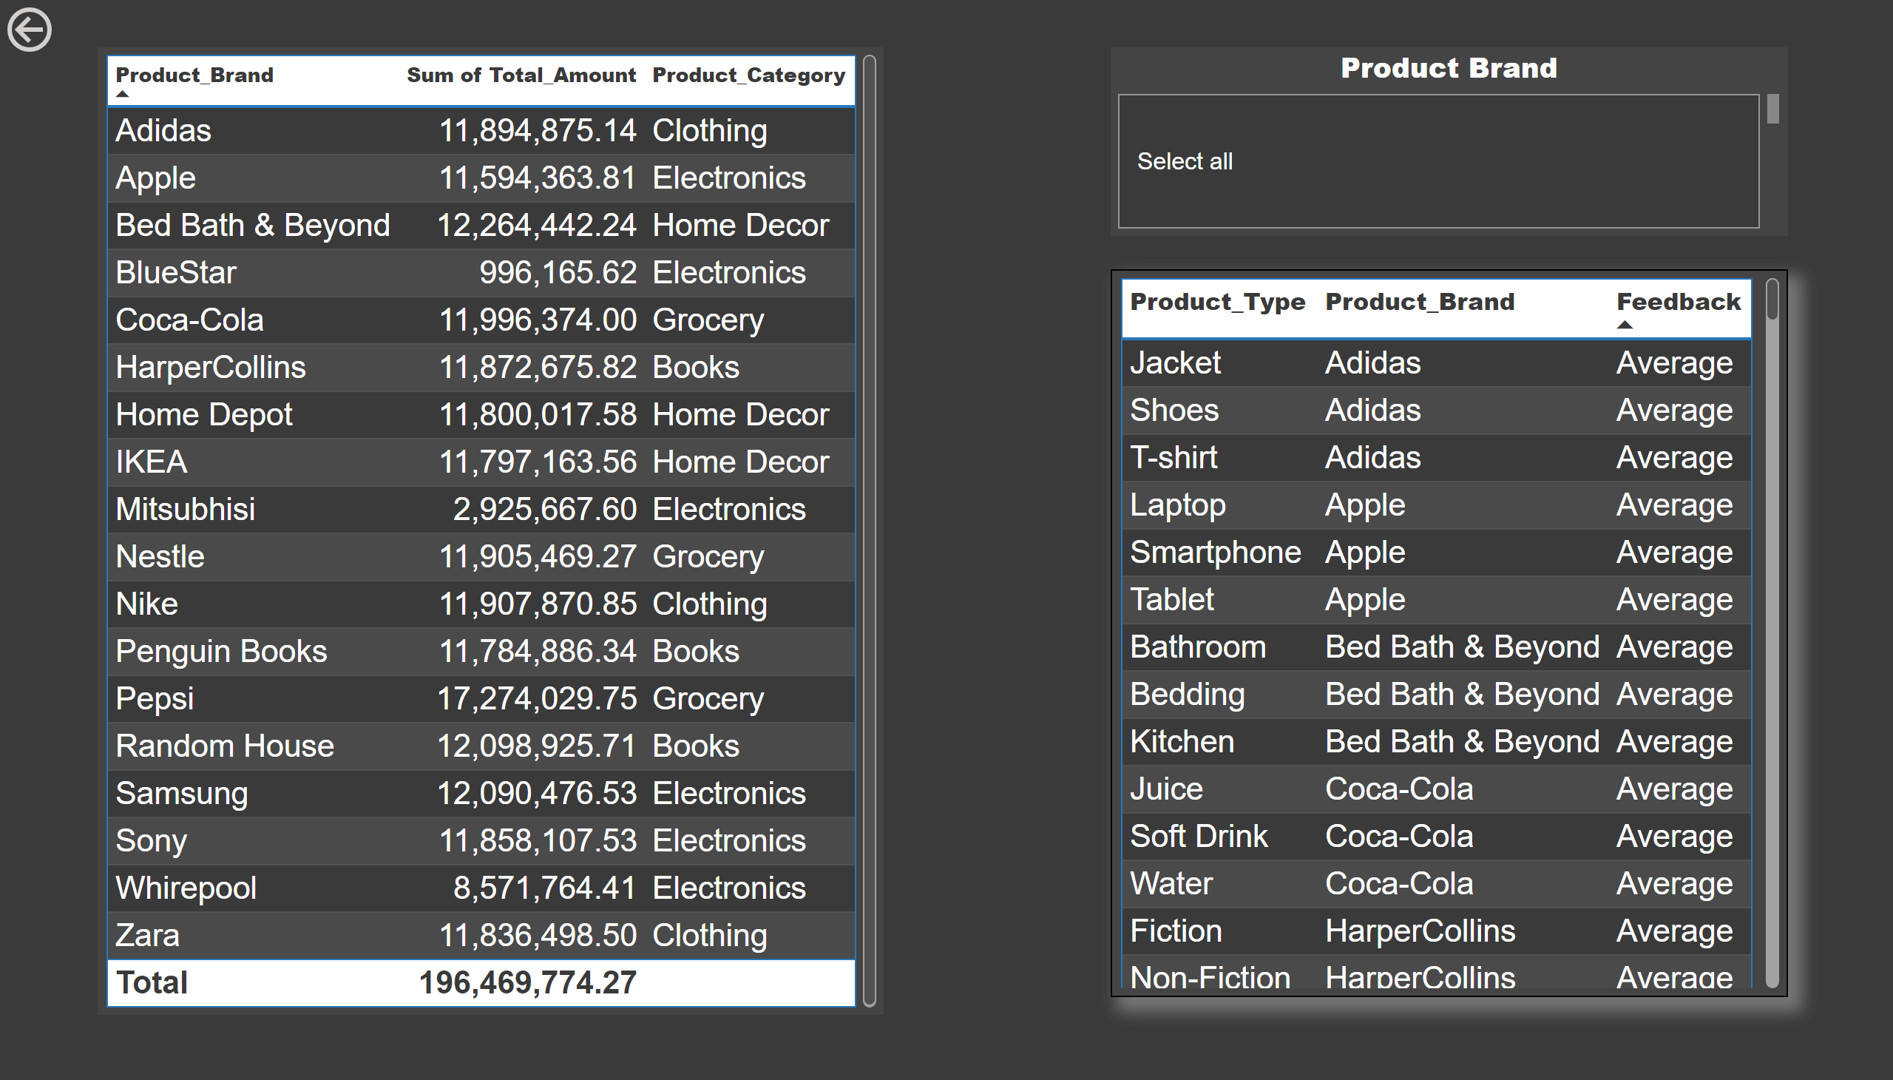
Product Information
Notes:
tableEx
No alt text provided
tableEx
No alt text provided
actionButton
No alt text provided
Product Brand
No alt text provided

Slide 5
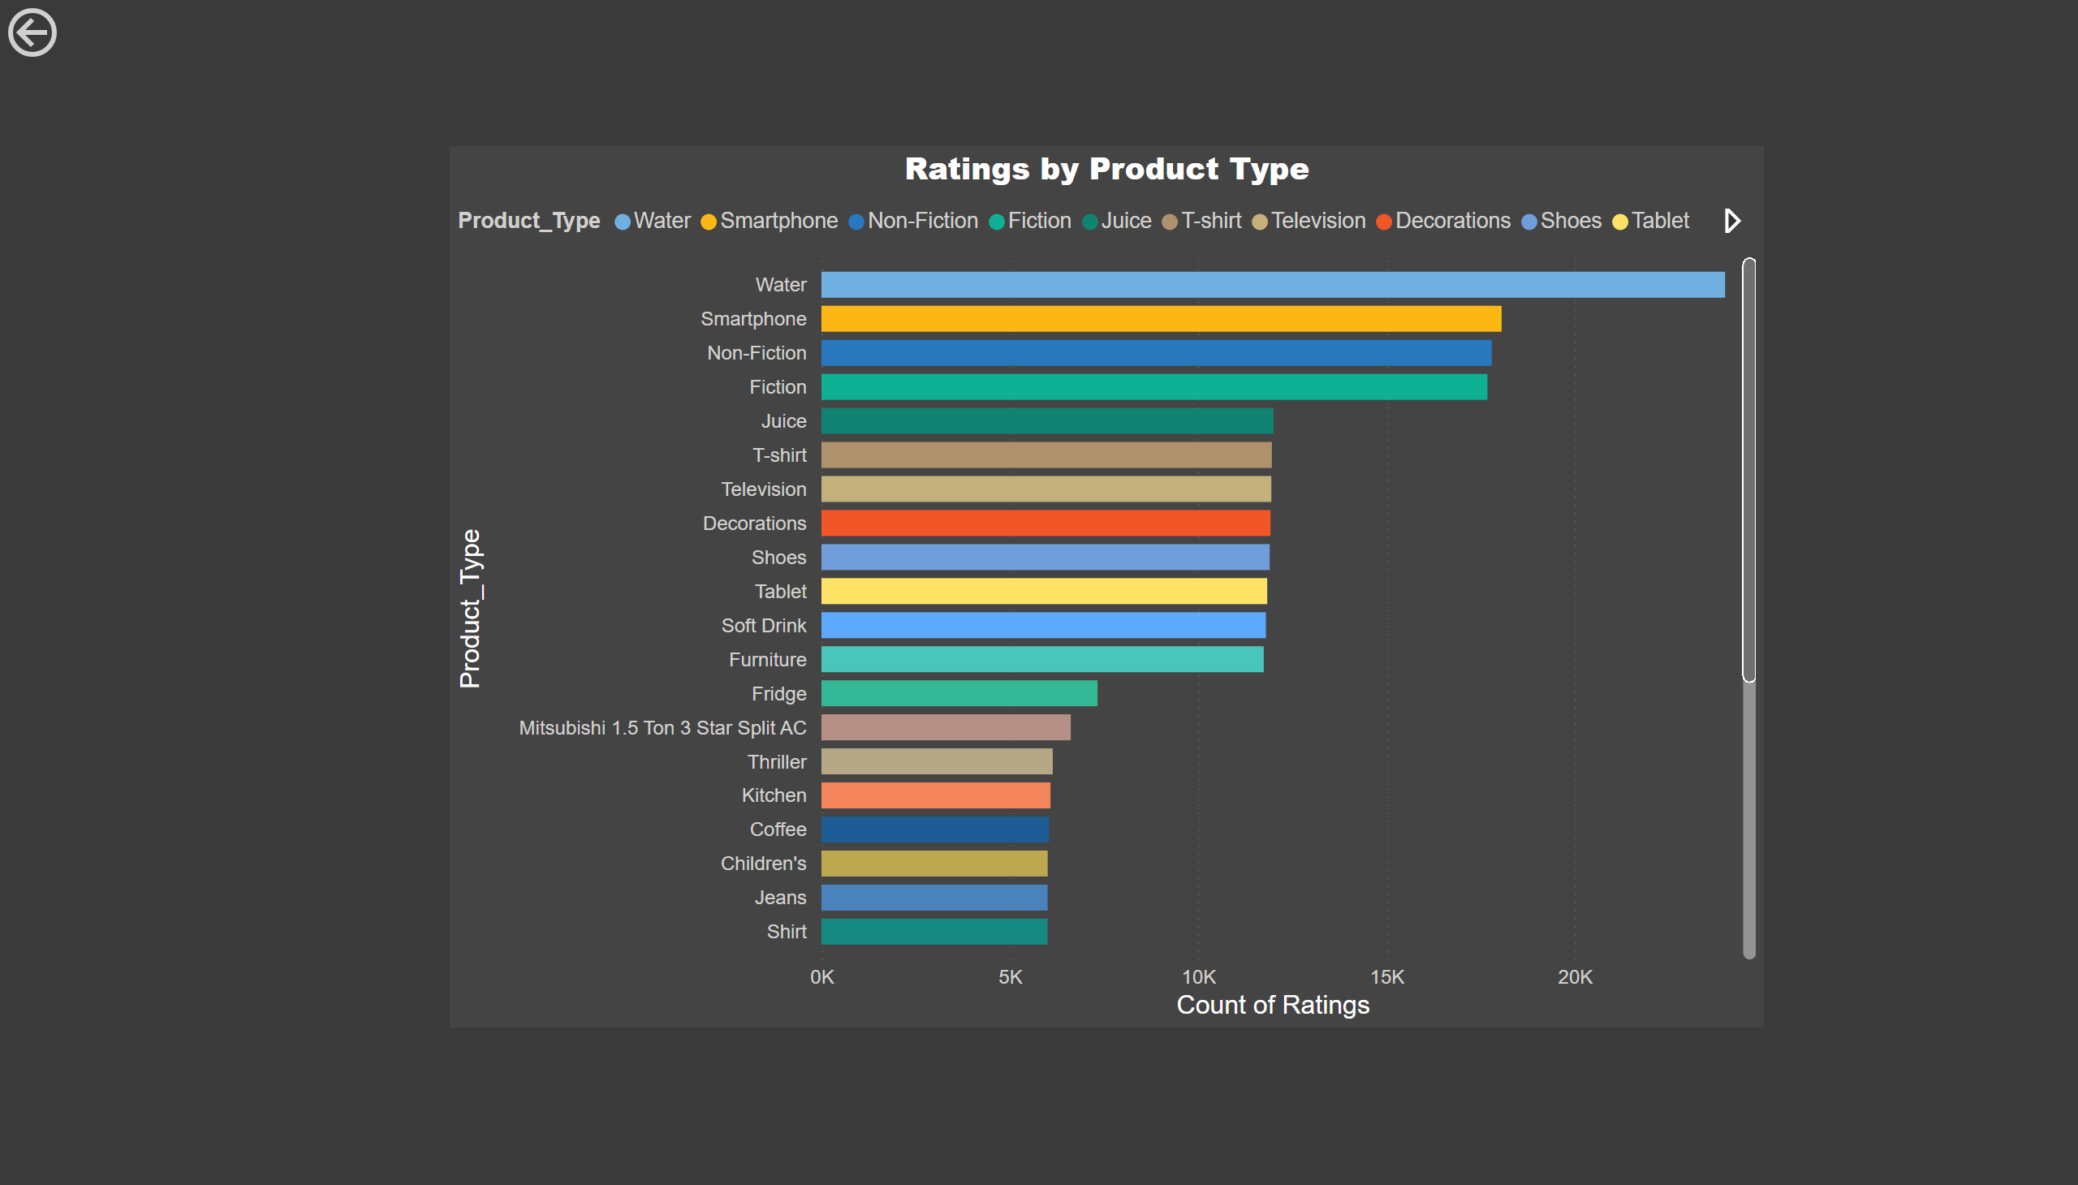
Ratings
Notes:
Ratings by Product Type
No alt text provided
actionButton
No alt text provided

